Slide 1
Expression Classification from Facial Images
Student Name: Aftab Nafees
Section: DSAI Section 1
Roll Number: DSAI-GB-002
GitHub Username: aftab1038
GitHub Project Rep Link: https://shorturl.at/04oVm
Date: October 19, 2024

Slide 2
Project Overview
Objective: Develop a model to classify facial expressions into 7 categories
Dataset: Expression in the Wild (ExpW) with 100,000 images, 36,000 used for training
Model: Fine-tuned VGG16 with custom classification layers for expression detection

Slide 3
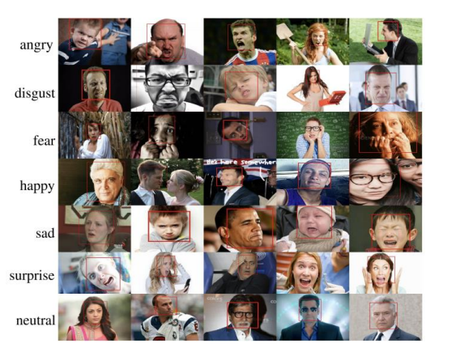
Dataset Details
ExpW dataset contains 91,793 labelled face images in 7 categories:
Angry, Disgust, Fear, Happy, Sad, Surprise, Neutral
Data split: 80% training, 20% testing
Images were pre-processed and normalized before training

Slide 4
Model Architecture (VGG16)
• Pre-trained VGG16 used as the base model
• Custom layers added for emotion classification
• Optimizer: Adam, Learning rate: 0.001
• Training for 10 epochs

Slide 5
Hyperparameter Tuning
• Model showed robust performance with 91% test accuracy
• Training accuracy of 98% reflects strong learning capabilities
• Class imbalance and diverse image quality affected performance

Slide 6
Results
• Training Accuracy: 98%
• Test Accuracy: 91%
• Validation Accuracy: 92%
• Observed slight overfitting between training and validation accuracy

Slide 7
Model Performance Analysis
• Model showed robust performance with 91% test accuracy
• Training accuracy of 98% reflects strong learning capabilities
• Class imbalance and diverse image quality affected performance

Slide 8
Analysis & Future Work
Techniques for improving generalization:
Data augmentation
Regularization (dropout)
Cross-validation
Further training and testing on diverse datasets recommended

Slide 9
Conclusion
Model demonstrated promising accuracy for facial expression classification
Useful in psychology, human-computer interaction, and security
Future work includes enhancing model generalization and robustness

Slide 10
Thank you
Aftab Nafees
Aftabk.1038@gmail.com
https://shorturl.at/04oVm

